Slide 1
Built-In Blocks Sources & Sinks

Slide 2
Built-In Blocks Sources & Sinks
Simulink models are built primarily by connecting the appropriate blocks
Sources: are inputs into the model
Sinks: are outputs of the model

Slide 3
Built-In Blocks Sources & Sinks
Sources: There are many options, including but not limited to:
  Constant
  Sinusoidal function
  Step function
  Ramp function
  Pulse function

Slide 4
Built-In Blocks Sources & Sinks
Sinks: Again there are many options:
  Display (shows numeric value)
  Scope (plotted value vs. time)
  XYGraph (plot one variable vs. another)
  To file (could import into Excel)
  To workspace (can plot from Matlab)

Slide 5
Built-In Blocks Sources & Sinks
Blocks: There are too many blocks to describe, so browse through them and see what is available
Many of these blocks will be more useful when you use them in controls classes

Slide 6
Built-In Blocks Sources & Sinks
Most blocks will give you more information about their “settings” if you double click on them
Sometimes it is helpful to put inputs on the right side of the block and outputs on the left. To do this, right click on the block and select Format…Flip Block

Slide 7
Built-In Blocks Sources & Sinks
One helpful feature that is not really a block is a text box to describe what is being passed from one block to the next
To use this, double click on an empty space and type. This will generate a comment line.

Slide 8
Saving Simulink Files
When you save a Simulink file it is given an extension name of “.mdl”

Slide 9
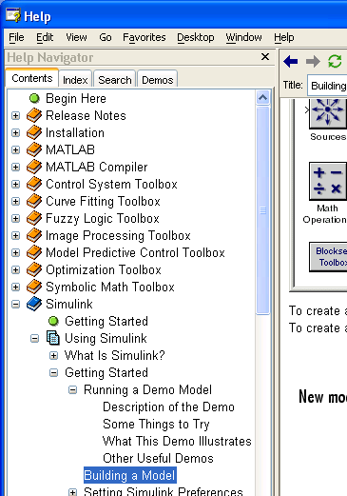
Built-In Blocks Sources & Sinks
From the Help window select the Contents tab
Go to Simulink / Using Simulink / Getting Started…
Click on “Building a Model”
Follow the instructions and build a model

